Slide 1

SRM VALLIAMMAI ENGINEERING COLLEGE (AUTONOMOUS INSTITUTION) DEPARTMENT OF INFORMATION TECHNOLOGY
THE ACADEMIC YEAR 2022-2023(EVEN SEMESTER)
PROJECT PHASE 1- SECOND REVIEW
AI BASED WILDFIRE PREDICTION GUIDED BY: Dr.S.NARAYANAN B.E., M.Tech., Ph.D., Assistant Professor (Sel.G)
TEAM MEMBERS:
HARISHANKARAN B – 142219205031
HARSHAVARTHAN H – 142219205032
JAIPRAKASH M – 142219205035
JEDIN TONY J - 142219205040

Slide 2
ABSTRACT
Wildfires are Increased over the years due to a rise in temperature, increased intensity of drought, and other Global warming factors. It destroys forest resources that cause a severe impact on Ecology balance. The Algorithm used to predict before a Wildfire is a logistic regression, we built a model and trained it with the Weather data collected. With that previous forest fire incidents have happened. By predicting earlier we may alert the forest department.

Slide 3
INTRODUCTION
Forest resources are the most important natural resources on earth.
Wildfires occur naturally under certain Meteorological.
Wildfires are destructive and spread rapidly.
Predicting before the start of a wildfire is very useful.
Forest fires are 3 types Crown fires, surface fires, and Ground fires.
Simple logistic regression model used to train data.
It has a high accuracy rate of prediction.

Slide 4
OBJECTIVES
To Prevent Forest Fires.
Save the Animals and Habitants using ML algorithm.
Train the machine with historic weather data.
Weather data includes temperature, humidity, and oxygen.
In logistic regression, it returns true(1) or false(0) by probability.
If the probability is higher then inform the fire prevention team.
By prior Informing Wildfire can be prevented.

Slide 5
LITERATURE SURVEY
S.NO | TITLE | YEAR | METHODOLOGY | BENEFITS
1. | A Neural Network Model for Wildfire Scale Prediction Using Meteorological Factors | 2019 | A backpropagation neural network (BPNN), a recurrent neural network (RNN), and long short term memory (LSTM) models are deployed. | A backpropagation neural network (BPNN), a recurrent neural network (RNN), and long short term memory (LSTM) models are deployed.
2. | A backpropagation neural network (BPNN), a recurrent neural network (RNN), and long short term memory (LSTM) models are deployed. | 2013 | A backpropagation neural network (BPNN), a recurrent neural network (RNN), and long short term memory (LSTM) models are deployed. | Based on Information received at base station Intelligent decision were made.

Slide 6
LITERATURE SURVEY
S.NO | TITLE | YEAR | METHODOLOGY | BENEFITS
3. | Forest Fires Segmentation using Deep Convolutional Neural Networks | 2021 | To Overcome limitation like false detection of fire pixels. They propose three deep convolutional networks U- Net, U2-Net, and Efficient Seg. | This models shows good performance in terms of accuracy and proved reliability to segment fire pixels
4. | Decision Tree based System on Chip for Forest Fires Prediction | 2020 | This method based on Intellectual property core development for forest fire prediction. To speed up the process by decision locally at sensor node level. | Hardware implementation results of the decision tree based forest fires prediction system on chip show that the developed IP core.
5. | Deep Learning Approach to Predict Forest Fires Using Meteorological Measurements | 2021 | This project rely on Forest Fire Weather index Information. Long short term memory (LSTM) model used to deploy prediction of forest fire. | Since various metrics are used to evaluate the accuracy of proposed model. Results shows proposed models produce reasonable predictions.

Slide 7
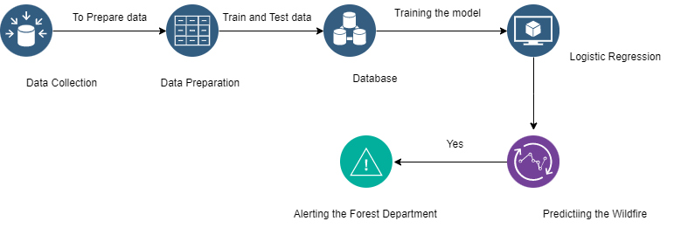
ARCHITECTURE DIAGRAM

Slide 8
CHALLENGES
Data collection - collecting historic data.
Data Preparation – data cleansing, removing duplicates.
Algorithm selection – Selecting the high accuracy algorithm.
Train and Test- segmenting the train and test data.
- Deployment machine accur y are very lowered compared to Train and test.

Slide 9
MODULES DESCRIPTION
Data Collection
Collecting the weather data to train the model.
2. Data Preparation
Prepare the collected data to remove outliers, void, and duplicate data.
3. Train and Test
To train and test data the machine with the Logistic Regression.
4. Streamlit app
To Run the ML model on localhost and it fetches user input.

Slide 10
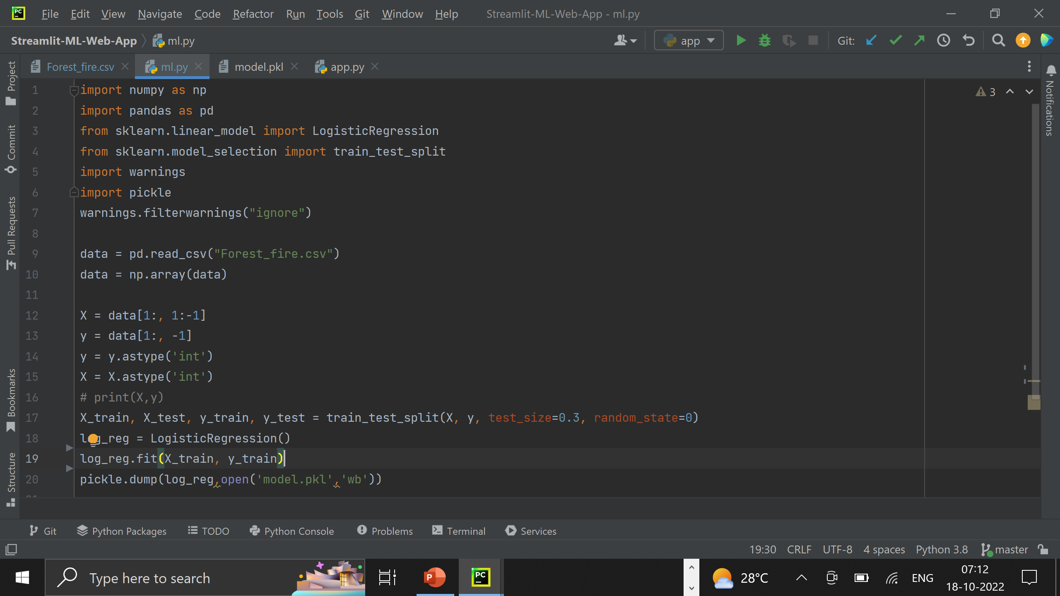
ML model

Slide 11
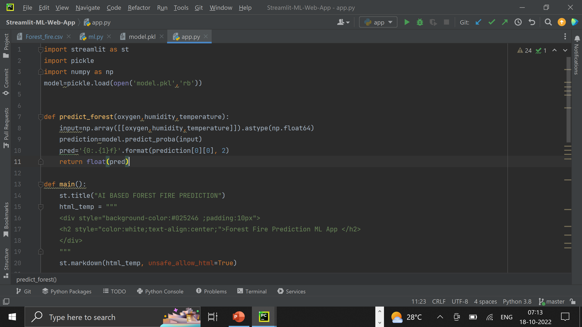
Streamlit app

Slide 12
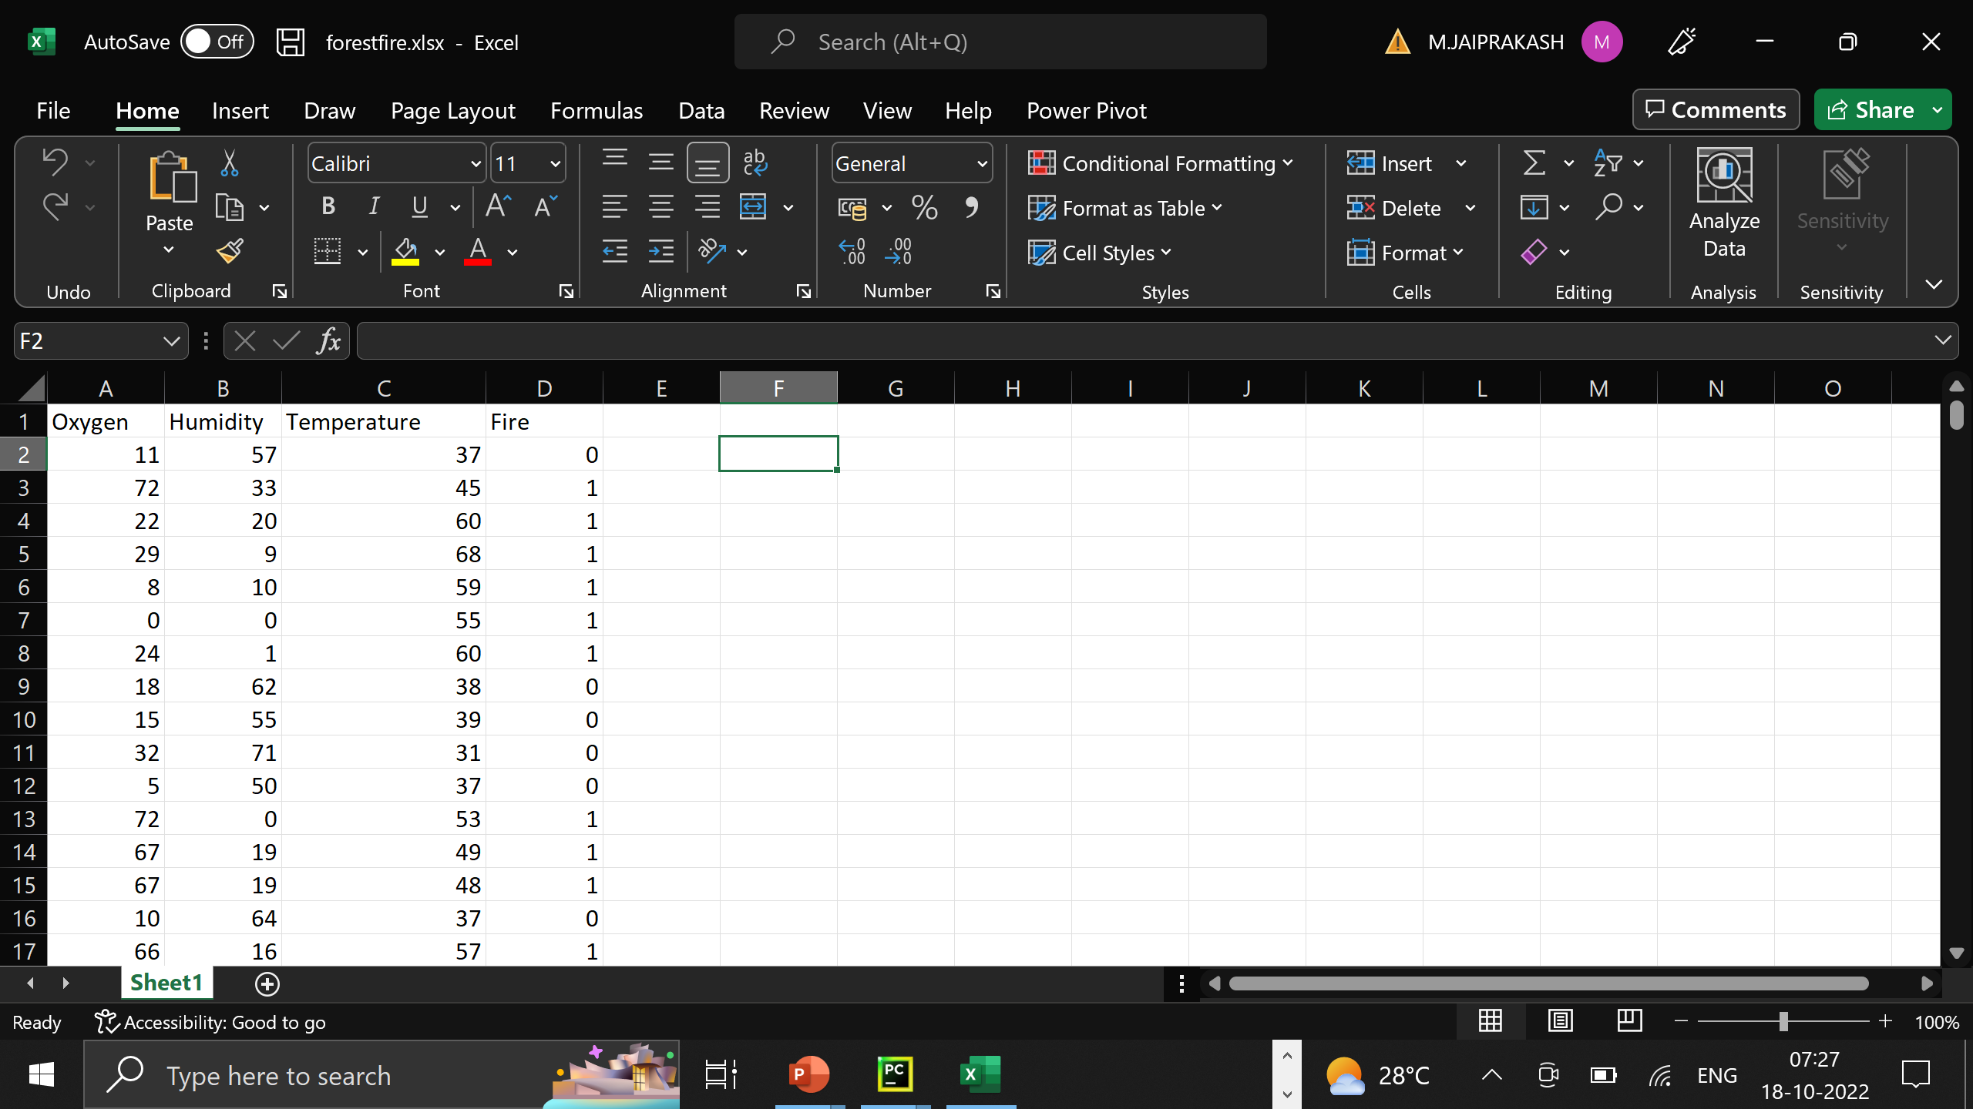
Prepared data

Slide 13
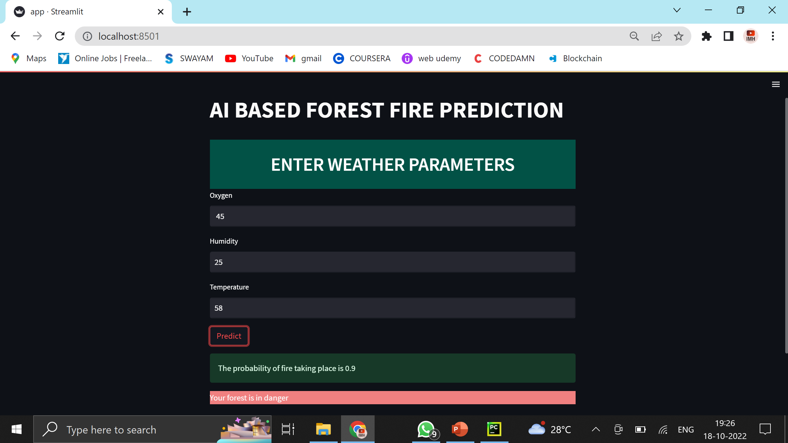
OUTPUT

Slide 14
BASE PAPER
A Neural Network Model for Wildfire Scale Prediction Using Meteorological Factors
HAO LIANG , MENG ZHANG , AND HAILAN WANG
School of Technology, Beijing Forestry University, Beijing 100083, China
Beijing Laboratory of Urban and Rural Ecological Environment, Beijing 100083, China
Key Lab of State Forestry Administration for Forestry Equipment and Automation, Beijing 10083, China

Slide 15
THANK YOU

